Slide 1
Docker Fundamentals

Slide 2

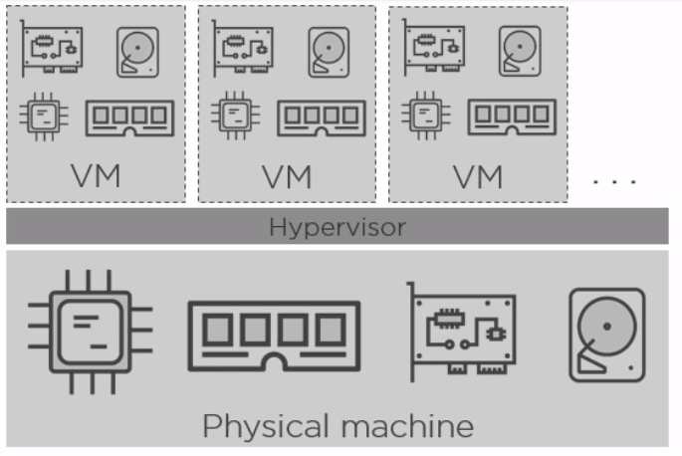
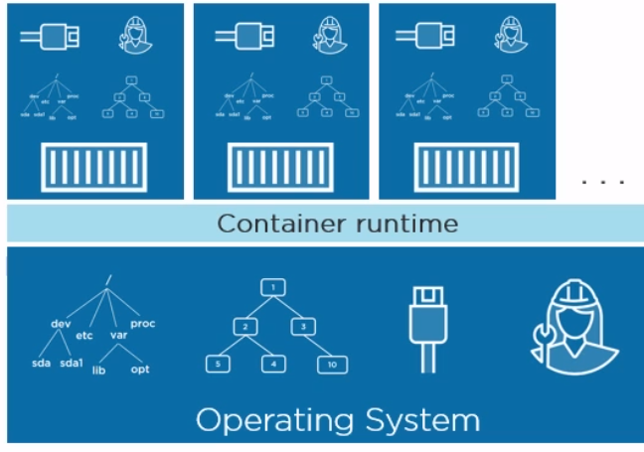
Containers vs Virtual Machine
OS
OS
OS
Notes:
We are in a world of virtualization. Virtualization attempts to make better utilization of resources. There are 2 modes of virtualization available VM and Containers.
Any virtualization works around 2 concepts: NameSpaces and Control Groups
By default these concepts are Linux Kernel primitives but there are equivalent concepts on windows platform as well.
NameSpaces are about Isolation, Control Groups are about grouping objects ex namespace and setting limits.
Lets look at VM first:
VM virtualization works on top of a virtual machine manager like hypervisor. To achieve virtualization it grabs physical resources like CPU, RAM, storage, networks, then, it slices them into virtual versions, so virtual CPU, virtual RAM, virtual NICs, all that goodness, and then it builds virtual machines out of them, virtual machines that look, smell, and feel like normal physical servers. But in the end we end up running guest OS over the Host OS layer. This makes it bulkier and takes time to start as it need to boot up the Guest OS additionally to provision a VM.
Lets look into Containers:
Well not so with containers. Now, keeping this somewhat high-level here,
instead of slicing and dicing physical server resources, Docker and other container engines slice and dice operating system resources. So, they slice up the process namespace, the network stack,
the storage stack, the file system hierarchy actually. In effect, every container gets its own PID1, process ID 1, every container gets its own root file system, that's obviously / on Linux and c on Windows.
So, hypervisor virtualization virtualizes physical server resources and builds virtual machines. Container engines like Docker, they're more like operating system virtualization, they create virtual operating systems, assign one to each container, inside of which we run applications. And they're way more lightweight than VMs.

Slide 3
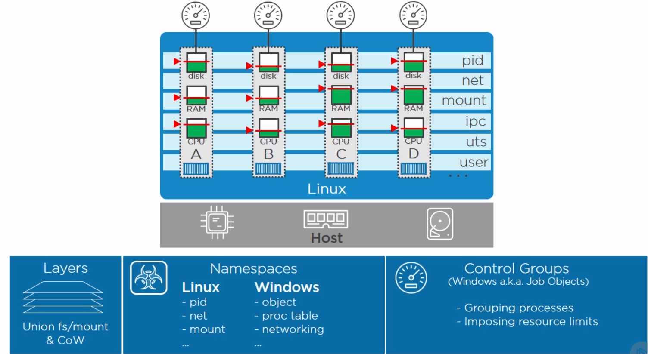
Containers on Linux
docker run -it --cpus=".5" ubuntu /bin/bash

Slide 4
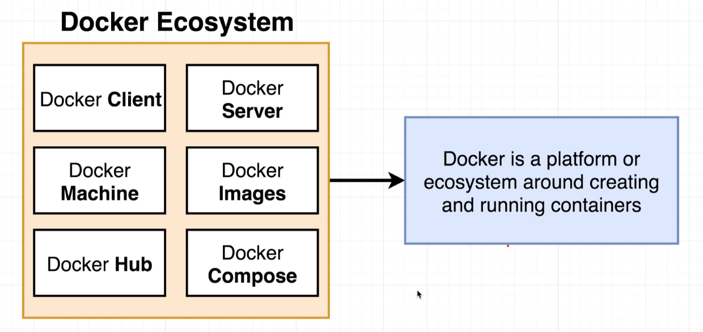
What is Docker?
Docker is a tool designed to make it easier to create, deploy, and run applications by using containers. Containers allow a developer to package up an application with all of the parts it needs, such as libraries and other dependencies, and ship it all out as one package.
Notes:
Docker is a collection of tools that provides different capabilities to build an eco-system to run containers.
Docker Machine: Docker Host running docker core engine.
Docker Client: Docker CLI client
Docker Server: Docker dameon server side process that accepts commands from Docker client.
Docker Hub: Central location that hosts the repositories containing docker images.

Slide 5
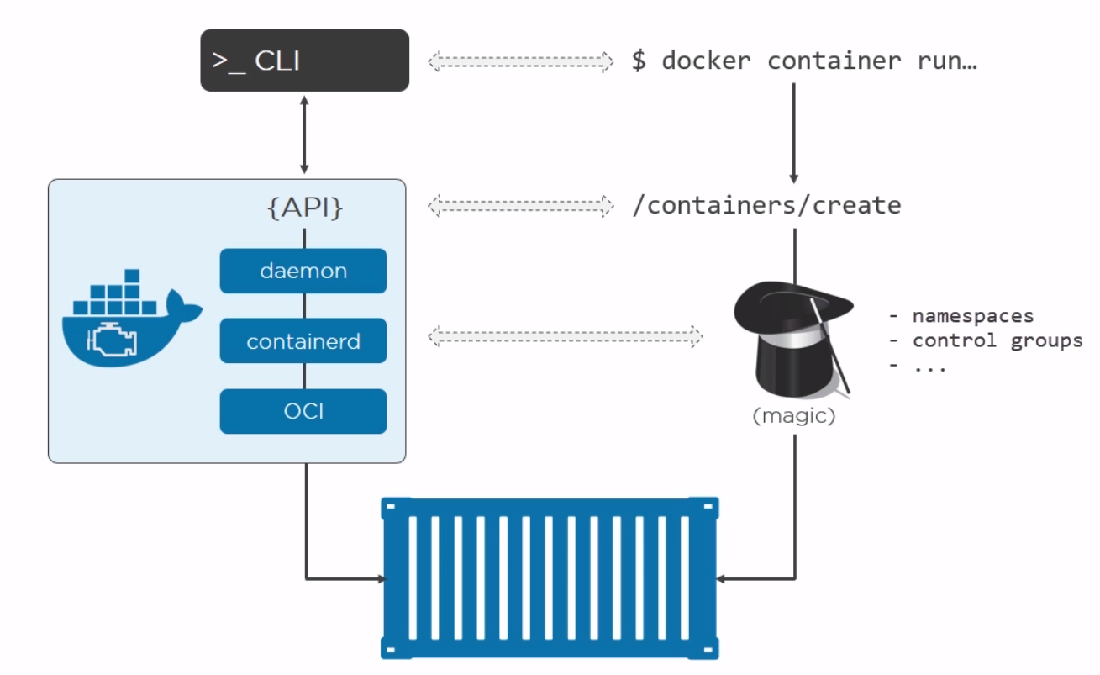
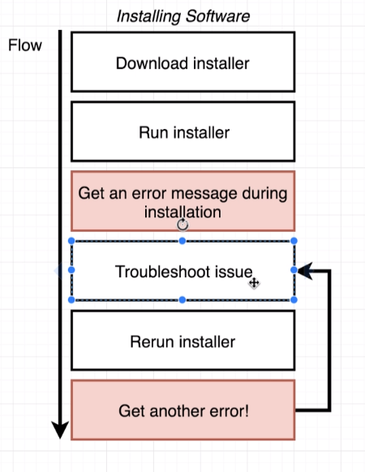
Why Docker?
Docker Containerization Unlocks the Potential for Dev and Ops.
The Docker Enterprise container platform delivers immediate value to your business by reducing the infrastructure and maintenance costs of supporting your existing application portfolio, while accelerating your time to market for new solutions.
Potential Use Case:
Consistent Deployment across environments
Lift and Shift Support across platforms.
CI/CD Pipelines
Testing
Notes:
Hides the complexity of dealing with Name Space and Control Groups for virtualization
Reduces the effort configuring the software across multiple server(s)/environments
Can be leveraged for :
Consistent Deployment across environments
Lift and Shift Support across platforms.
CI/CD Pipelines
Testing

Slide 6
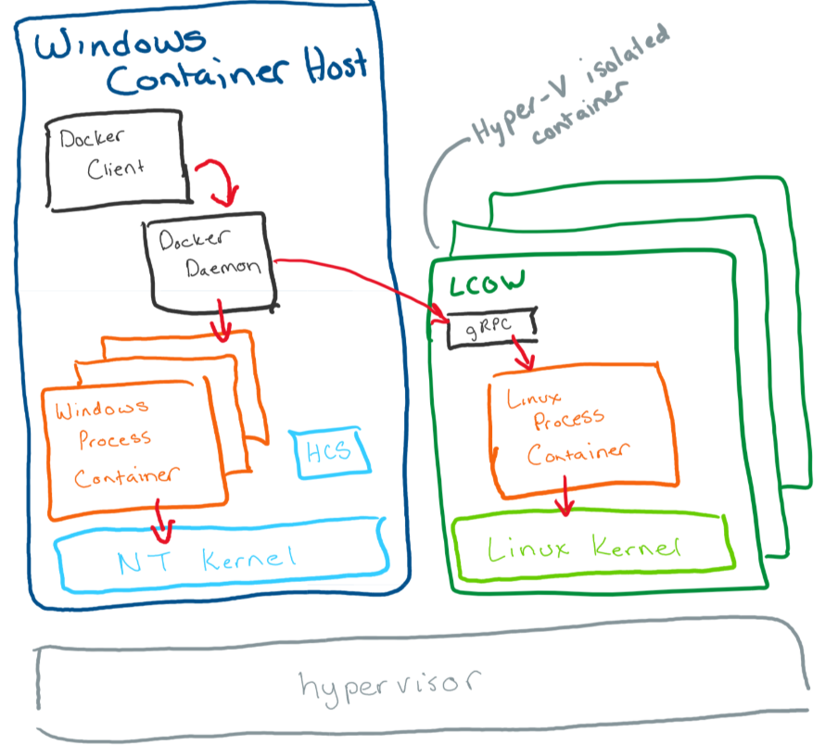
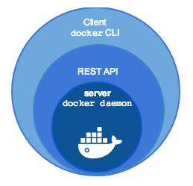
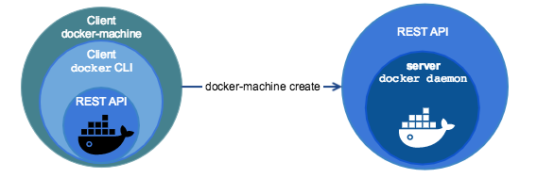
Getting Setup: No Support for A3
Install Docker Toolbox or Docker For Windows (Windows 10 pro)
Setup the Docker Machine
Start and Connect to the Docker Machine
Log into Docker Registry
Pull Image, start a container.
Glossary
Docker Machine
Boot2Docker
Docker Client
Docker Engine
Repositories
Image
Container
Notes:
Toolbox includes these Docker tools:
Docker Machine for running docker-machine commands
Docker Engine for running the docker commands
Docker Compose for running the docker-compose commands
Kitematic, the Docker GUI
A shell preconfigured for a Docker command-line environment
Oracle VirtualBox
Images - The file system and configuration of our application which are used to create containers. To find out more about a Docker image, run docker inspect alpine. In the demo above, you used the docker pull command to download the alpine image. When you executed the command docker run hello-world, it also did a docker pull behind the scenes to download the hello-world image.
Containers - Running instances of Docker images — containers run the actual applications. A container includes an application and all of its dependencies. It shares the kernel with other containers, and runs as an isolated process in user space on the host OS. You created a container using docker run which you did using the alpine image that you downloaded. A list of running containers can be seen using the docker ps command.
Docker : Docker Client + Docker Engine (Docker Dameon)
Docker daemon - The background service running on the host that manages building, running and distributing Docker containers.
Docker client - The command line tool that allows the user to interact with the Docker daemon.
Docker Store - A registry of Docker images, where you can find trusted and enterprise ready containers, plugins, and Docker editions
Boot2Docker:
Boot2Docker is a minimalist Linux distribution with the sole purpose to run Docker containers.The Boot2Docker distribution was based on Tiny Core Linux and runs completely from RAM.
The ISO installation occupied 27 MB. Boot2Docker started up in around 5 seconds. The Boot2Docker team encourages users and people in search of a way to run Docker on
Microsoft Windows and Apple MacOS to use Docker Machine. The Docker Machine tool installs Docker Engine on virtual hosts. Docker Engine deploys and runs containers from images.
What is Docker Machine:
Docker Machine is a tool that lets you install Docker Engine on virtual hosts, and manage the hosts with docker-machine commands. You can use Machine to create Docker hosts on your local
Mac or Windows box, on your company network, in your data center, or on cloud providers like Azure, AWS, or Digital Ocean.

Slide 7
Installation and Setup Links
Outside
https://docs.docker.com/toolbox/toolbox_install_windows/
UBS Links

Slide 8
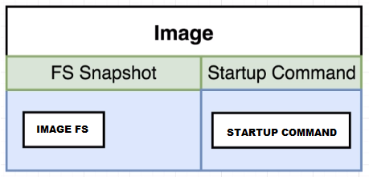
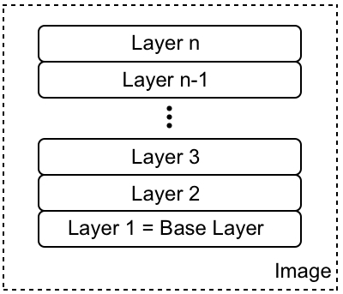
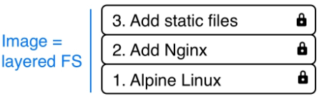
Docker Image
Docker Images are file system snapshots along with optional entry point command details. Docker images are created using Dockerfile. Dockerfile is nothing but a series of commands that incrementally build the docker image.
Docker leverages Linux Union File System to lay out its images.
docker image ls
docker image inspect [image guid|tag]
docker build .
Notes:
What are Images:
In Linux, everything is a file. The whole operating system is basically a filesystem with files and folders stored on the local disk. This is an important fact to remember when looking at what container images are. As we will see, an image is basically a big tarball containing a filesystem. More specifically, it contains a layered filesystem.
The first layer in the image is also called the base layer. The layers of a image are all immutable. Immutable means that once generated, the layer cannot ever be changed.
Each individual layer contains files and folders. Each layer only contains the changes to the filesystem with respect to the underlying layers. Docker uses a union filesystem to create a virtual filesystem out of the set of layers. A storage driver handles the details regarding the way these layers interact with each other.
Each layer only contains the delta of changes in regard to the previous set of layers. The content of each layer is mapped to a special folder on the host system, which is usually a subfolder of /var/lib/docker/.
Union File System.
The UnionFS forms the backbone of what is known as container images. UnionFS is mainly used on Linux and allows files and directories of distinct filesystems to be overlaid and with it form a single coherent file system. In this context, the individual filesystems are called branches. Contents of directories that have the same path within the merged branches will be seen together in a single merged directory, within the new, virtual filesystem. When merging branches, the priority between the branches is specified. In that way, when two branches contain the same file, the one with the higher priority is seen in the final FS.

Slide 9
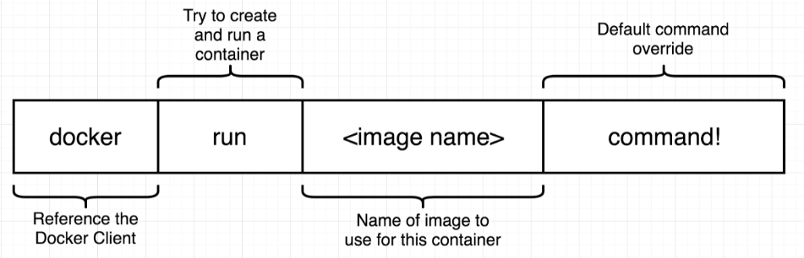
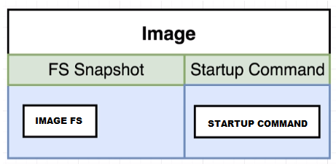
Docker Container
Docker Container is a running instance of a Docker Image
Example:
docker run --name busyboxechowelcome busybox echo Welcome Mark
docker run --name busyboxechobye busybox echo Bye Mark
docker ps –a
docker start busyboxechowelcome -a
docker start busyboxechobye -a
Other useful commands:
docker ps –a
docker create –name[container user friendly name] [image:tag]
docker stop –name[container user friendly name]
docker pause –name [container user friendly name]
docker container inspect [container id or name]
ECHO …….
BUSY BOX
IMAGE
Create Container
Name
Container Start
Port
Name:Tag
Command
Network
Env Variables
Command
Running Container
Executes Entry Command
Container Exit
Sits in Exit state
BUSY BOX
ECHO …….
Notes:
Container Life Style:
What happens when container is first created?
Creating a container and running a container are separate processes.
When we are creating the container we are just setting up the File System Snap Shot to be used to create the container.
When we start the container, the configured Entry point command is executed.
One point to remember is that once a container is created its state is well established and it will always execute through same state whenever started.
Also its important to note that container exits after it has successfully completed its entry point commands. Ex: BusyBox exited after executing the start up command.
Typical apache containers holds the tomcat in listening mode so they don’t exit once started, unless tomcat has stopped or crashed for some reasons.
Any commands that are specified with the docker run will be appended to the entry point command list.
docker run = docker create + docker start
docker start –a : this –a flag will attach the container stdin|stdout stream to the host and it will display the execution outputs.

Slide 10
Packaging Applications Using Docker
Examples and Deck:
https://github.com/CodeItOnGit/simple-springboot-project
https://github.com/CodeItOnGit/presentations

Slide 11
Simple Docker File

Slide 12
Multi Step Docker File

Slide 13
Scaling Docker Containers

Slide 14
Docker Compose
Notes:
Environment Variable Precedence:
When you set the same environment variable in multiple files, here’s the priority used by Compose to choose which value to use:
Compose file
Shell environment variables
Environment file
Dockerfile
Variable is not defined

Slide 15
Useful commands : Docker CLI
docker-machine create: Create a docker machine based on boot2docker vm.
docker-machine inspect: Displays docker machine configuration in json format.
docker ps: List all running containers.
docker images ls : List all local images.
docker pull [image|tag]: Pulls the specified image from the connected docker repository.
docker push [image|tag]: Pushes the specified image from the connected docker repository.
docker build: Builds the docker image using Dockerfile
docker create [OPTIONS] IMAGE [COMMAND] [ARG...]: The docker create command creates a writeable container layer over the specified image and prepares it for running the specified command. The container ID is then printed to STDOUT. This is similar to docker run -d except the container is never started
docker run [OPTIONS] IMAGE[:TAG|@DIGEST] [COMMAND] [ARG...] : Runs a docker container from image.
docker container start [Container ID]: Starts a docker container.
docker rm $(docker ps -aq) : Deletes all containers from local host.
docker rmi $(docker images -q): Deletes all images from local cache.
docker stats [container name/ID] [container name/ID] : Show the current load on each container specified – it will show CPU%, memory usage, and network traffic.
docker logs [-f] [container name/ID]: Shows the latest output from the container. The -f option “follows” the output, much like a console “tail-f” command would.
docker inspect [container name/ID]: Dumps all of the configuration information on the container in JSON format.
docker port [container name/ID]: Shows all of the port forwarding between the container host and the container.
docker exec [-i] [-t] [container name/ID]: Executes a command on the target container (-i indicates to run interactively, -t is pseudo-tty). This command is very commonly used to get a container shell:

Slide 16
Practice Links
https://docs.docker.com/machine/get-started/
https://github.com/docker/labs/tree/master/beginner/
https://medium.com/@betz.mark/ten-tips-for-debugging-docker-containers-cde4da841a1d
https://github.com/docker/labs/blob/master/developer-tools/java/chapters/ch02-basic-concepts.adoc
https://fly.io/articles/load-balancing-a-fleet-of-docker-containers-using-fly/

Slide 17
Assignment
Complete open JDK docker file to run application as stand alone container.
Use Open JDK instead of Tomcat to execute the war/jar file.
Hint:
FROM openjdk:8-jdk-alpine

